Slide 1

Predicting Credit Cards Approvals
Date:
September 13, 2022
Prepared by:
Yazan Hannun
Track:
Data Science

Slide 2
Table of Contents
Introduction
Implementation
APIs
Conclusion
References

Slide 3
Introduction
Commercial banks receive a lot of applications for credit cards each year, but many of them are denied.
There are many reasons why someone might not get approved for a credit card:
Poor credit score
No or low income
Too many debts already.

Slide 4
Introduction
Manually analyzing these applications is:
mundane
error-prone
and time-consuming (time is money!)
Luckily, this task can be automated with the power of machine learning.

Slide 5

Implementation Overview
In this project a machine learning model based on supervised learning algorithms has been built to predict the approval status of customers applications.
Labeled Data
Approved
Neptune is the farthest planet from the Sun
Prediction
Model Training
Labels
Denied
Approved
Denied
Test Data

Slide 6
Implementation Viewing the dataset
0:Gender
1:Age
2:Debt
3:Married 4:BankCustomer 5:EducationLevel 6:Ethnicity 7:YearsEmployed 8:PriorDefault 9:Employed
10:CreditScore 11:DriversLicense 12:Citizen
13:ZipCode
14:Income 15:ApprovalStatus
 | 0 | 1 | 2 | 3 | 4 | 5 | 6 | 7 | 8 | 9 | 10 | 11 | 12 | 13 | 14 | 15
0 | b | 30.83 | 0.000 | U | G | w | v | 1.25 | t | t | 1 | f | g | 00202 | 0 | +
1 | a | 58.67 | 4.460 | U | G | q | h | 3.04 | t | T | 6 | f | g | 00043 | 560 | -
2 | a | 24.50 | 0.500 | U | ‘?’ | q | h | 1.50 | t | F | 0 | f | g | 00280 | 824 | +
3 | b | 27.83 | 1.540 | U | g | w | v | 3.75 | t | T | ‘?’ | t | g | 00100 | 3 | -
UCI Machine Learning Dataset [1]
[1]
"UCI Machine Learning Repository," [Online]. Available: http://archive.ics.uci.edu/ml/datasets/credit+approval.

Slide 7
Implementation Features Selection
Features like DriversLicense and ZipCode are not as important as the other features in the dataset for predicting credit card approvals. We should drop them to design our machine learning model with the best set of features.

Slide 8
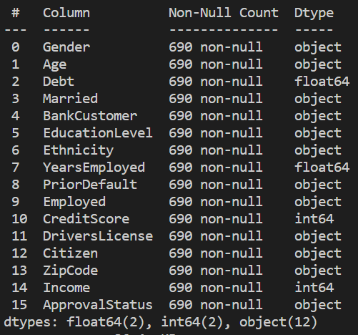
Implementation Inspecting the applications
There are a mix of numerical and non-numerical features in the dataset.
 | 2 | 7 | 10 | 14
count | 690.000000 | 690.000000 | 690.00000 | 690.000000
mean | 4.758725 | 2.223406 | 2.40000 | 1017.385507
std | 4.978163 | 3.346513 | 4.86294 | 5210.102598
min | 0.000000 | 0.000000 | 0.00000 | 0.000000
25% | 1.000000 | 0.165000 | 0.00000 | 0.000000
50% | 2.750000 | 1.000000 | 0.00000 | 5.000000
75% | 7.207500 | 2.625000 | 3.00000 | 395.500000
max | 28.000000 | 28.500000 | 67.00000 | 100000.000000
Applications’ Descriptive Statistics
Data Types in UCI Dataset

Slide 9
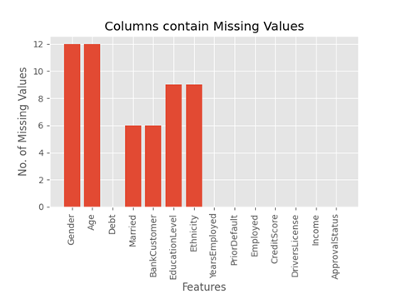
Implementation Handling missing values
Ignoring missing values can affect the performance of
a machine learning model heavily.
Impute the missing values in numerical features can
be handled with a strategy called mean imputation.
Impute the missing values in non-numerical features
can be handled with a strategy called most frequent
values.

Slide 10
Implementation Preprocessing the data
There are still some minor but essential data preprocessing needed before we proceed towards building our machine learning model:
Convert the non-numeric data into numeric using Label Encoding
Scale the feature values to a uniform range using MinMaxScaler

Slide 11
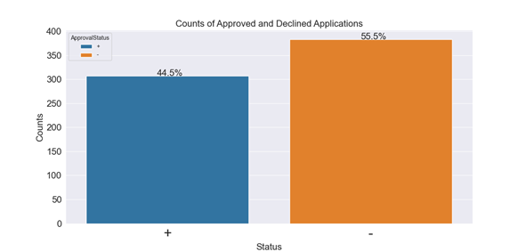
Implementation Fitting a model
According to UCI, our dataset contains more instances that correspond to "Denied" status than instances corresponding to "Approved" status.
307 (44.5%) applications that got approved
383 (55.5%) applications that got denied
Counts of Approved or Declined Applications in UCI Dataset

Slide 12
Implementation Fitting a model
This gives us a benchmark. A good machine learning model should be able to accurately predict the status of the applications with respect to previous statistics.
Which model should we pick? since the output should be labeled a classification model should be picked
The two models are Logistic Regression and KNeighborsClassifier.

Slide 13
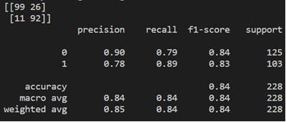
Implementation Fitting a model: Logistic Regression
Results:
• Accuracy of LogisticRegression for train data: 0.8744588744588745
• Accuracy of LogisticRegression for test data: 0.8377192982456141
Statistics:
Approved =
Denied =
Classification Report:

Slide 14
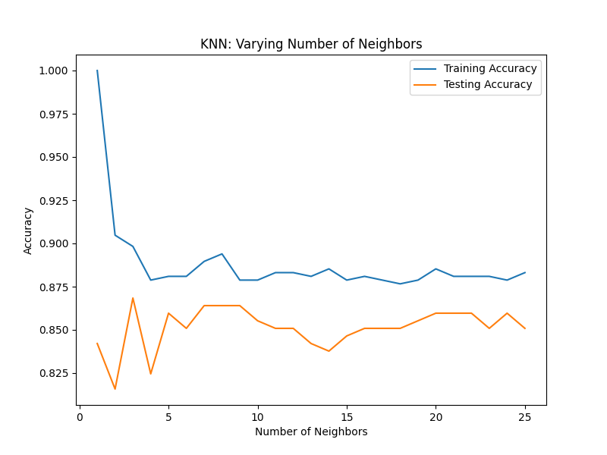
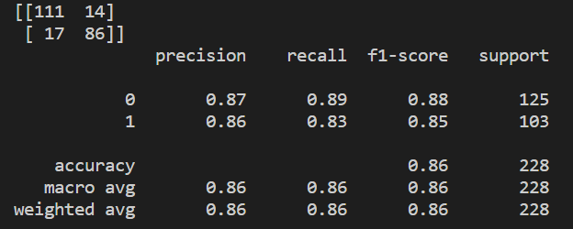
Implementation Fitting a model: K-Nearest Neighbor
Results:
Accuracy of KNeighborsClassifier for train data: 0.8939393939393939
Accuracy of KNeighborsClassifier for test data: 0.8640350877192983
Statistics:
Approved =
Denied =
Classification Report:

Slide 15
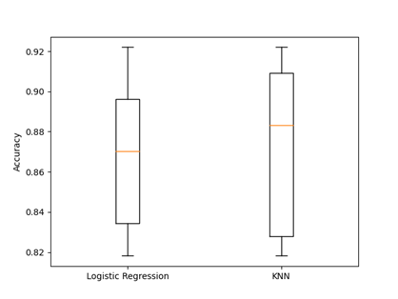
Implementation Fitting a model: Evaluating classification models performance
Performance of logistic regression and KNN (n_neigbours = 8)

Slide 16
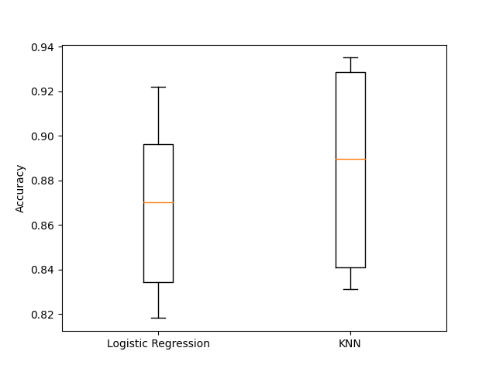
Implementation Fitting a model: Hypertuning models using GridSerachCV
Model | Data | Before Hyper tuning (n = 8) | After Hyper tuning (n = 22) (tol=0.01, max_itr = 100)
KNN | Train Accuracy | 0.893939 | 0.88528
 | Test Accuracy | 0.864035 | 0.86
Logistic Regression | Train Accuracy | 0.874458 | 0.86796
 | Test Accuracy | 0.837719 | 0.84
KNN and Logistic Regression models comparison
KNN and Logistic Regression models comparison

Slide 17
Application Program Interface (API)
After creating the model and choosing the best performing one, two APIs will be created the first one will retrieve applications from the client for example (a bank) and then send back a .xlsx report to the client contains the predictions of the status of their customers credit card applications. Moreover, the sqlite database should also be auto synchronized to a cloud database (Firebase). Below a description of how to create such APIs

Slide 18
Application Program Interface (API) API 1
Retrieve the data from the client
Handle and preprocess the data for prediction
Create SQLite database and insert the predictions
Synchronize the data into a cloud database

Slide 19
Application Program Interface (API) API 2
This API was built in case the client wants a report about the predictions of the file, which has already sent in API 1. After receiving a request to generate a report, this API will generate a report as an excel file contains the CustomerID, date of prediction and status of this customer application.

Slide 20
Conclusion
I have tried two different classification models for the credit card approval prediction task. The train and test accuracy of the models is summarized in the Table.3 below. I have obtained the best test data accuracy (89.39%) from the KNN classifier. The small difference in train and test accuracy scores indicates the absence of overfitting and underfitting.

Slide 21
References

Slide 22
Thank you

